Slide 1
Coursera Capstone IBM Data Science Opening a new restaurant in Toronto, CA
By: Numan Talha Ayhan
December 2020

Slide 2
Intro
Turkish Cuisine is a very luxurious kitchen. Filled with lots of different recipes and meals it would be an honor to spread it across the world. Toronto being as diverse and a hot destination for tourists, we believe there are lots of benefits to opening restaurants in this location. Entrepreneurs who own Turkish based restaurants that can fit with the wants and needs of the western culture would be a great target segment.

Slide 3
Business Problem
The objective of this project is to analyze and select the best locations to build a restaurant.
Choosing a location that is less crowded with restaurants but also not to far into the suburbs.
Business question:
What is the better location to open a fine dining Turkish Cuisine in the area of Toronto?

Slide 4
Data
Data:
List of neighborhoods in Toronto
Latitude & Longitude coordinates of those neighbors
Venue data from Foursquare API
Source:
Foursquare API
Geocoder
Wikipedia
(https://en.wikipedia.org/wiki/List_of_postal_codes_of_Canada:_M)
CSV file of coordinates:
http://cocl.us/Geospatial_data

Slide 5
Methodology
Web scraping Wikipedia
Merging scraped data frame with latitude/longitude CSV file
Using Foursquare credentials to call venues with a limit of 100 in the Toronto area
Filtering and creating new data frames that include only data needed: neighborhood, venue category, latitude, longitude
Use one hot encoder to receive binary values
Cluster with k-means and sort based on cluster
Visualize with folium to see clustered neighborhoods in Toronto to finalize the analysis.

Slide 6
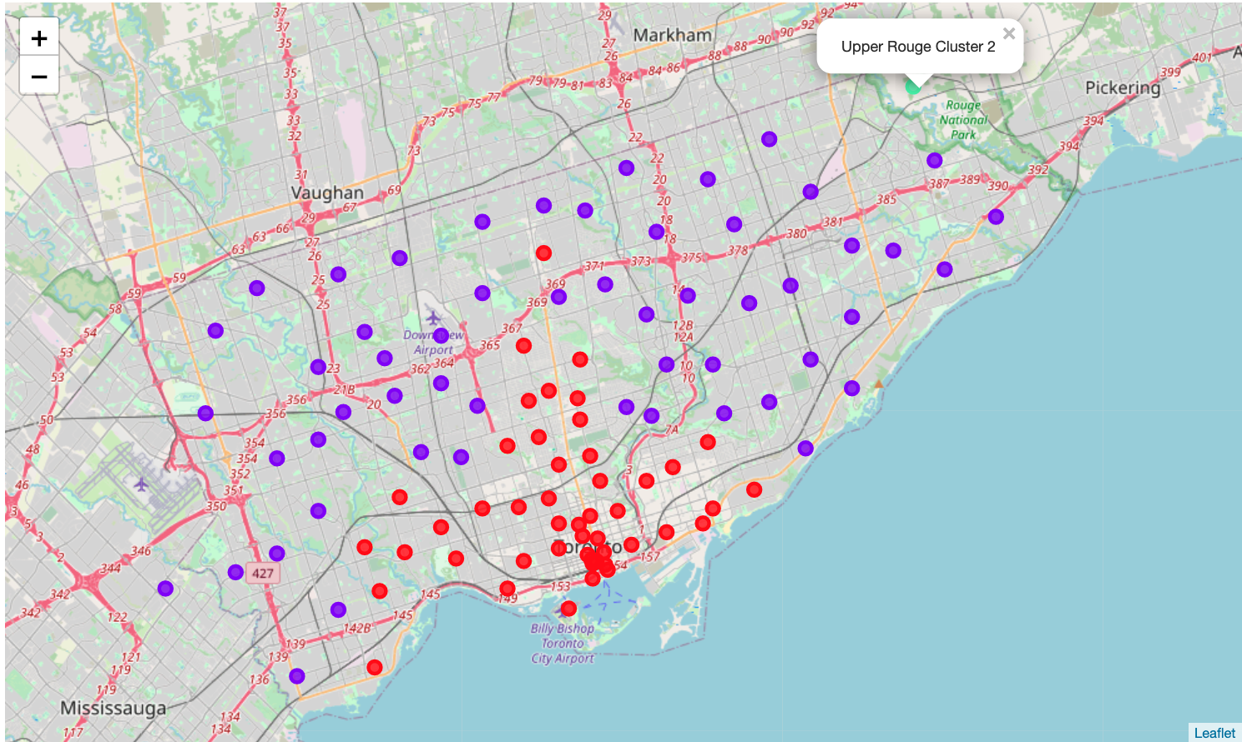
Results
Neighborhoods were clustered into 3 categories:
Cluster 0: 48 Red markers
Cluster 1: 54 Purple markers
Cluster 2: 1 Green Marker

Slide 7
Discussion
There was a large difference between cluster 2 compared to cluster 1 and 0.
The downtown area being cluster 0 was more tightly packed then cluster 1.
Cluster 2 (green) was only 1 and further north then the other locations.

Slide 8
Recommendations
We advise to open a restaurant in cluster 1(purple). Although there are more in this cluster, they are widely spread out compared to cluster 0 (red).
Being in cluster 1 would increase chances of sales as this would mark uniqueness of menu and more room to market with less competion around.
Being distant from downtown also betters chances with parking spaces and a calmer environment.

Slide 9
Conclusion
Custer 1(purple) is the recommendation to opening a new restaurant.
Although we did not look into types of restaurants in the areas for example Italian or regular dine in. we focused on the quantity of the restaurants in the areas. If more analysis is wanted and stakeholders request to be in cluster 0, there can be another analysis made so that there is not two Italian restaurants side by side.

